Slide 1
Early American Detroit 1787-1820

Slide 2
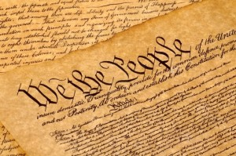
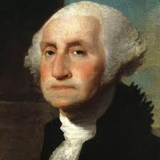
1789
- The true birthday of the United States (Constitution ratified, and George Washington becomes president in a national government)
http://www.biography.com/people/george-washington-9524786
http://www.the1789project.com/1789-project-pledge-signers-2/

Slide 3
Jacob Young
First black person to own land in Detroit after buying from a French settler.

Slide 4
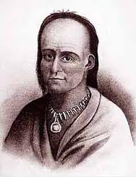
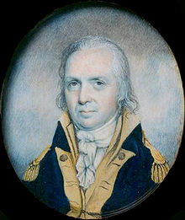
“Just and Lawful Wars”
http://www.supremecourt.ohio.gov/MJC/places/littleTurtle.asp
1790 - 1794 - “Little Turtle’s War” – Miami Chief Little Turtle and Shawnee War Chief Blue Jacket lead the Miami Confederacy against the U.S. military against Governor Arthur St. Clair and Josiah Harmar
1790 – Harmar defeated, 183 dead
1791 – St. Clair defeated, 630 dead (worst defeat)
Little Turtle
Josiah Harmar was court-martialed at his own request, but exonerated
Arthur St. Clair – the
first governor of the Northwest Territory died in poverty
http://en.wikipedia.org/wiki/Josiah_Harmar
http://en.wikipedia.org/wiki/Arthur_St._Clair

Slide 5
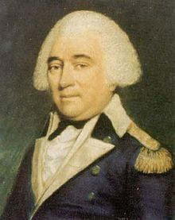
“Mad” Anthony Wayne
Earned nickname in the Revolutionary War with his daring tactics
Trained his 2,500 men for over a year in Indian warfare tactics
“The Americans are now led by a chief who never sleeps…. The day and the night are alike to him during the times he has marched on our villages. In spite of the watchfulness of our braves, never have we been able to surprise him. Think well of it! There is something that whispers to me it would be prudent to listen to offers of peace.”
- Little Turtle, 1794
http://en.wikipedia.org/wiki/Anthony_Wayne

Slide 6
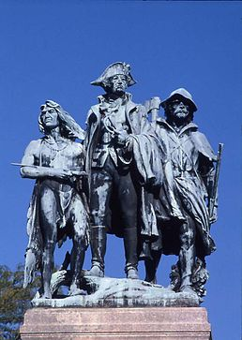
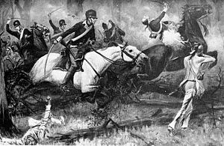
Battle of Fallen Timbers, 1794
Blue Jacket’s force of 1,000 – 1,500 warriors attacked Wayne’s men south of present-day Toledo (Maumee). British at nearby Fort Miamis made no attempt to aid Indians, because it would have led to war with U.S.
A recent tornado blew down many trees
Wayne’s 3,000+ men overwhelmed Indians in brief battle. Called the “last battle of the American Revolution.”
This statue at shows Anthony Wayne flanked by a Native American and a frontiersman.
http://en.wikipedia.org/wiki/Battle_of_Fallen_Timbers
http://en.wikipedia.org/wiki/Battle_of_Fallen_Timbers_Monument

Slide 7
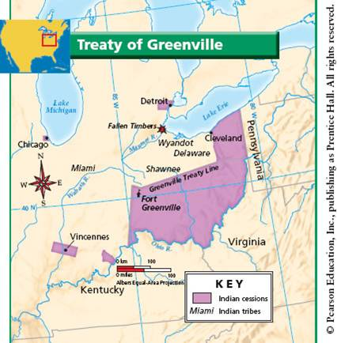
The Treaty of Greenville (1795)
Treaty of Greenville (in Ohio) cedes most of Ohio and Indiana to the Americans.
Six mile wide strip along Detroit River from Monroe to Lake St. Clair (as well as Mackinac Island) was first Michigan land ceded by Indians
Indians received goods valued at $20,000, and a promise to get $9,500 in goods per year in perpetuity.
http://54091304.weebly.com/the-northwest-territories.html

Slide 8
What happened to anthony wayne?
Built Fort Wayne in Fort Wayne, IN in Oct. 1794
Negotiated the Treaty of Greenville in 1795
Died of gout on December 15, 1796.
15 states have a Wayne County, and 5 states have a Wayne Township.
7 cities are called Wayne, Fort Wayne or Waynesboro

Slide 9
“Treaty-Making Period”- 1789-1871
500 treaties with Indian tribes
Dealt with tribes as with foreign nations, which had sovereignty
Indians ceded land, but sometimes retained usufructory rights: hunting, fishing, and gathering rights.

Slide 10
Treaty Cessions created Michigan
Treaty of Greenville, 1795
Treaty of Detroit, 1807
Foot of the Rapids Treaty, 1817
Saginaw Treaty, 1819
Sault Ste. Marie, 1820
Chicago Treaty, 1821
Carey Mission, 1828
Chicago Treaty, 1833
Treaty of Washington, 1836
10. Cedar Point Treaty, 1842
11. Treaty of La Pointe, 1842
https://www.cmich.edu/library/clarke/ResearchResources/Native_American_Material/Treaty_Rights/Text_of_Michigan_Related_Treaties/Pages/Map-of-Treaty-Cessions.aspx

Slide 11
2011 MDNR Notice
“The Department of Natural Resources reminds the public that certain fishing opportunities for tribal members of tribal governments located within the 1836 Treaty of Washington and 1842 Treaty of La Point are different than those allowed for state-licensed recreational anglers under Michigan law, and that these activities may be observed this spring.”
“As established under the 2007 Inland Consent Decree, Tribal members may use spears or conventional fishing tackle to take walleye and steelhead in some waters of Michigan covered by the 1836 treaty. Similarly, a tribally-regulated, spring subsistence spear fishery is present in the western portion of the Upper Peninsula within the 1842 Treaty area. These activities may occur during periods when these waters are closed to fishing for State-licensed recreational anglers.”

Slide 12
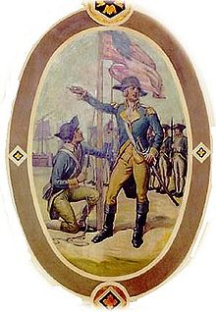
Detroit FinallY becomes American
http://en.wikipedia.org/wiki/Jean_Fran%C3%A7ois_Hamtramck
Jay’s Treaty (1795) - British agree to abandon all their forts in the Northwest Territory, including Fort Lernoult (renamed Fort Detroit), and Fort Mackinac
July 11, 1796 – Captain Moses Porter, under Lieutenant Colonel John Francis Hamtramck, who fought in Revolutionary War and at Fallen Timbers, raises American flag over Detroit. Anthony Wayne came to Detroit on August 13, but died a few months later.

Slide 13
Detroit becomes Wayne County
Aug. 15, 1796 – Wayne County includes most of Michigan, and parts of Ohio, Indiana, and Wisconsin
2/3 of 2,600 Detroit residents are French
1799 – Detroiter Solomon Sibley elected to legislature of the Northwest Territory

Slide 14
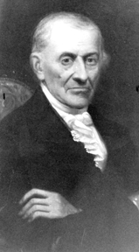
Michigan, 1796
Only 500 people (< 5,000 in all NW Territory)
Most in Detroit and Michilimackinac
Spoke French
Joseph Campau was the wealthiest citizen
William Macomb owned Grosse Ile (bought in 1776 from the Potawatomis), and owned 26 slaves. His son, Alexander, a hero of the War of 1812, is the namesake of Macomb County
Ruled by Governor of Northwest Territory Arthur St. Clair until 1800.
Campau
http://sibleyhousedetroit.com/the-campau-family/

Slide 15
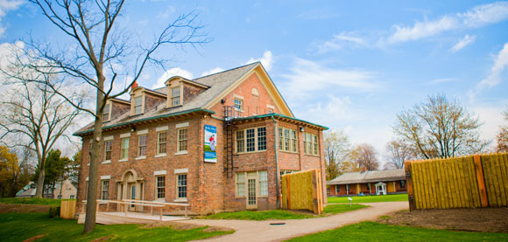
British build Fort AMHERSTBURG
British citizens swore oath of allegiance to Americans but British soldiers stayed close, and built two new forts near Detroit (Fort Amherstburg, south of Windsor) and Michilimackinac
Fort Amherstburg was built in 1796, but was destroyed when the British retreated during the War of 1812. The Americans built a new, smaller fort called Fort Malden, but gave it back to the British after the war.
http://www.pc.gc.ca/eng/lhn-nhs/on/malden/natcul.aspx

Slide 16
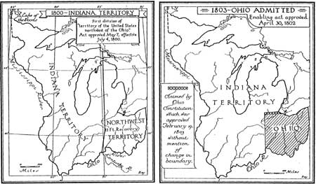
The 1800 and 1803 SPLIT
http://www.nps.gov/history/history/online_books/libo/hrs/hrs4a.htm
In 1800, Northwest Territory (and Michigan) was divided into the Indiana Territory in the west (Gov. William Henry Harrison), and Northwest Territory in the east under Arthur St. Clair.
In 1803, Ohio became a state and Michigan became part of Indiana Territory.
Detroiters complained that the new capital (Vincennes, IN) was too far and they had no representation, so wanted to create a Michigan Territory.

Slide 17
Detroit becomes a city
Feb. 1, 1802 – 20 acre City of Detroit is incorporated by Territorial Governor Arthur St. Clair

Slide 18
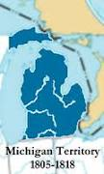
1805 – The Michigan Territory
Pres. Jefferson agrees to create separate Michigan territory with Detroit as the capital.
Little land available for settlement because not surveyed, and Indians still owned land except for around Detroit
British at Fort Malden controlled declining fur trade
Only 5,000 residents, 80% spoke French
http://en.wikipedia.org/wiki/Michigan_Territory

Slide 19
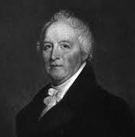
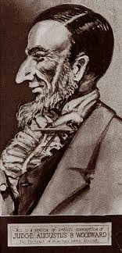
The Michigan Territory
http://familysearch.org/learn/wiki/en/Michigan_Territory_in_the_War_of_1812
Hull
Governor: William Hull (1805-1813)
Secretary: Stanley Griswold (1805-1808)
Judges: Augustus Woodward, Frederick Bates, and Samuel Huntington
Judge James Witherell replaced Bates in 1808
Woodward
http://en.wikipedia.org/wiki/Augustus_B._Woodward

Slide 20
June 11, 1805 – The Great Fire
http://detroithistorical.org/buildingdetroit/curriculum_early.php
John Harvey, the town’s baker, lit a pipe and the ashes lighted some hay in a barn. Almost all the buildings burned, except for Fort Detroit (formerly Fort Lernoult). Three years before, Detroit had adopted a code of fire regulations. All residents had to sweep their chimneys often, and have buckets and ladders to fight any fires.

Slide 21
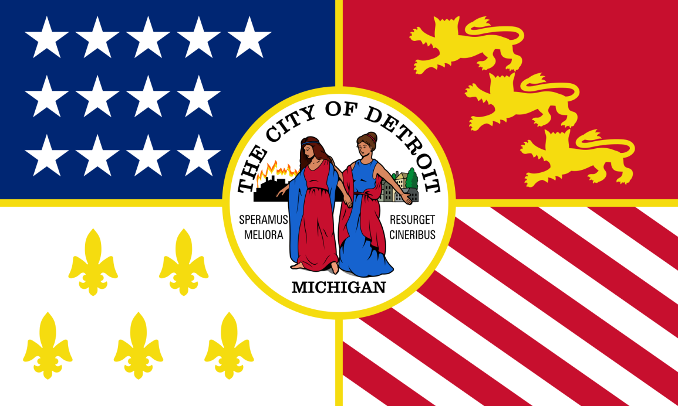
Rebuilding Detroit
Hull and Woodward went to Washington to ask for 10,000 acres of land
Each citizen over 17 received 5,000 sq. ft. plot of land
Only 900 people lived in Detroit
Houses now had stone foundations and sawed lumber, not logs, and bigger lots, wider streets, and open areas for parks
Thomas Palmer, a shop owner, built the first brick building in 1820.
Detroit’s flag was designed in 1907, and adopted in 1947.
The two Latin mottos read Speramus Meliora and Resurget Cineribus, meaning "We hope for better things" and "It will rise from the ashes," which was written by Gabriel Richard after the fire of 1805. The city adopted the seal and motto in 1827.
http://en.wikipedia.org/wiki/Flag_of_Detroit

Slide 22
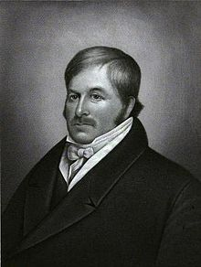
Sept. 13, 1806
Solomon Sibley becomes the first mayor of Detroit when the Michigan Territorial Council incorporates the City of Detroit
Less than three years later, the Territorial Governing Council revokes, when Detroit’s population is 770, and Michigan has 4,762 residents
http://en.wikipedia.org/wiki/Solomon_Sibley

Slide 23
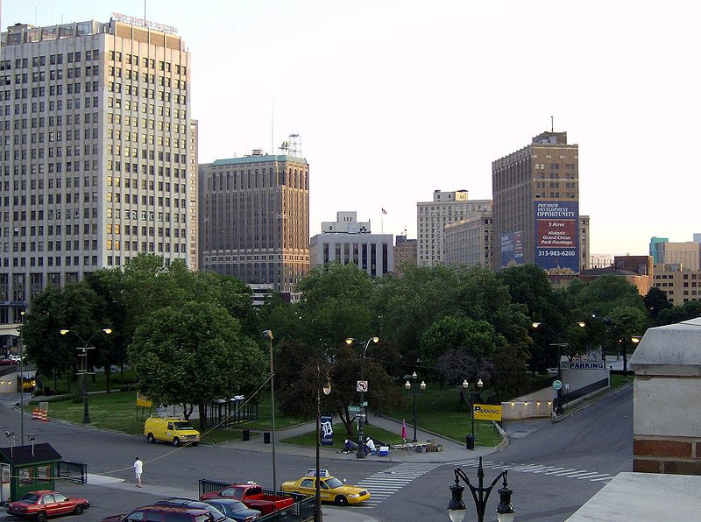
The Woodward Plan
Adams Road
Judge Woodward used Pierre L’Enfant’s design for Washington DC.
Circuses = Circular parks (1,000 feet diameter)
Main streets = 120 feet wide
Grand Avenue = 200 feet wide
In 1817, Judge Witherell and Gov. Lewis Cass reduced street size to 66 feet, and returned to the rectangular grid style.
Cass Ave.
Brush St.
http://en.wikipedia.org/wiki/Grand_Circus_Park_Historic_District
Map: Willis F. Dunbar and George May, Michigan: A History of the Wolverine State, 3rd Ed.(Grand Rapids, MI: Wm B. Eerdmans Publishing Co.), 115.

Slide 24
The Woodward Code
Made American laws that alienated the French inhabitants of Detroit
Required all slaves to be freed.
Woodward created the Bank of Detroit, but it failed
Woodward required new militia, but few Detroiters could afford the uniforms (arrested and whipped)
Repealed and replaced by Witherell Code in 1808, but reinstated in 1810
http://en.wikipedia.org/wiki/Augustus_B._Woodward

Slide 25
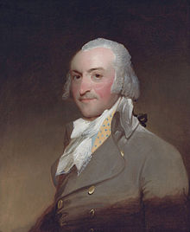
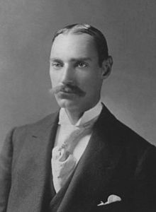
Conflict with the British
http://en.wikipedia.org/wiki/Fort_Kiowa
Governance of Detroit was poor from 1805-1812, and the Americans struggled to regain control from British who controlled fur trade in region
Tried “government factories” to control fur trade, but they failed because private traders got furs faster from Indians using rum
John Jacob Astor’s American Fur Company (1808) competed with British Mackinac Company, but eventually divided the trade. Silk hats replaced fur hats in the 1840s. Astor was the first multi-millionaire in the U.S.
Presence of British traders irked the Americans, who believed they were arming the Indians
Michigan was too sparsely settled, as land remained unsurveyed and still owned by Indians, unlike Ohio and Indiana
Astor
Great Grandson John Jacob Astor IV died
on the Titanic in 1912.
http://en.wikipedia.org/wiki/John_Jacob_Astor_IV

Slide 26
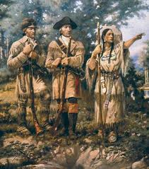
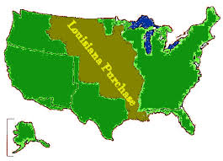
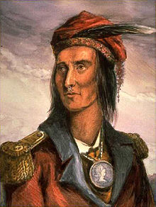
“Manifest Destiny” and the Indians’ Last Stand
http://www.art-prints-on-demand.com/a/paxson/lewisandclarkwithsacagawe.html
http://gatewayno.com/history/LaPurchase.html
1803 – Louisiana Purchase
1804 – Lewis and Clark leave St. Louis, get aid from Sacajawea, reach the Pacific on 11/5/1805.
1803 - Shawnee chief Tecumseh attempts to unite tribes in defense of their homeland: “Let us form one body, one heart, and defend to the last warrior our country, our homes, our liberty, and the graves of our fathers.”
http://en.wikipedia.org/wiki/Tecumseh

Slide 27
Father Gabriel Richard
1798 – Arrives in Detroit
1804 - Assistant Pastor at St. Anne’s Church in Detroit
1808 – Started school to train Indians in crafts and education
1809 - Owned the first printing press in Detroit and printed a spelling book, and published two periodicals (one and only issue of The Michigan Essay was published) but it was still the first Michigan newspaper.
http://en.wikipedia.org/wiki/Gabriel_Richard

Slide 28
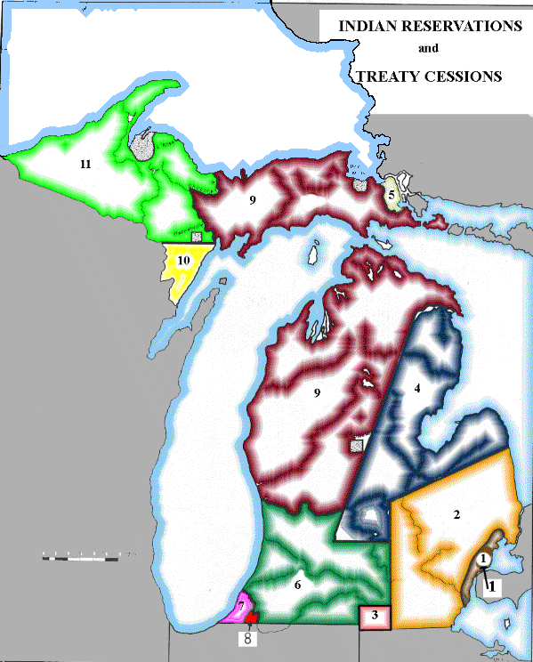
Governor William Hull
http://en.wikipedia.org/wiki/William_Hull
First Governor (1805-1813, reelected once)
1807 – Signed a peace treaty with four Indian tribes rumored to be ready for attack called the Detroit Treaty of 1807. Indians were paid $10,000 in goods ($.02/acre), and $2,400 per year in annual payments.
https://www.cmich.edu/library/clarke/ResearchResources/Native_American_Material/Treaty_Rights/Text_of_Michigan_Related_Treaties/Pages/Map-of-Treaty-Cessions.aspx

Slide 29
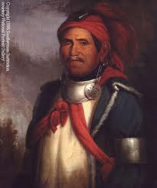
Tecumseh and “The Prophet”
Born Lalawethika “The Noise Maker”
Tecumseh =
“Shooting Star”
Had a vision in 1805, and became Tenskwatawa =
“The Open Door”
http://en.wikiquote.org/wiki/Tecumseh
http://en.wikipedia.org/wiki/Tenskwatawa
Shawnee war chief Tecumseh, and his brother, Tenskwatawa, called “The Prophet,” incited Indians to side with the British during the War of 1812. In 1806, “The Prophet” predicted a solar eclipse, and impressed Indian allies while humiliating William Henry Harrison. Tecumseh traveled extensively to organize tribes against the Americans.

Slide 30
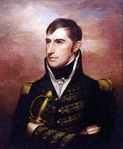
William Henry Harrison
Governor of the Indiana Territory 1801-1814 (pro-slavery)
Negotiated many land cession treaties with the Indians, using liquor, bribery, and threats. He found whatever chief he could to sign.
Indians in Midwest could not move West due to rival Sioux in Wisconsin.

Slide 31
“Sell a country! Why not sell the air, the great sea, as well as the earth? Did not the Great Spirit make them all for the use of his children?... Where today are the Pequot? Where are the Narragansett, the Mohican, the Pocanet, and other powerful tribes of our people? They have vanished before the avarice and oppression of the white man, as snow before the summer sun….Will we let ourselves be destroyed in our turn, without making an effort worthy of our race?” - Tecumseh
“Is one of the fairest portions of the globe to remain in a state of nature, the haunt of a few wretched savages, when it seems destined by the Creator to give support to a large population and to be the seat of civilization?”
- William Henry Harrison
http://en.wikipedia.org/wiki/Tecumseh
http://dstribling.wordpress.com/category/w-h-harrison/

Slide 32
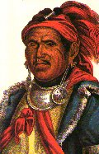
The Battle of Tippecanoe
http://en.wikipedia.org/wiki/Tecumseh
http://dstribling.wordpress.com/category/w-h-harrison/
1808 – Prophetstown built on Tippecanoe Creek in Indiana
1809 – Harrison gets Shawnee to sign the Treaty of Fort Wayne, ceding 3 million acres, so Tecumseh sought British allies
“one of those uncommon geniuses”
“Tippecanoe”
1811 – Battle of Tippecanoe - While Tecumseh was away, Tenskwatawa ordered attack, but Harrison (with 300 more men) won and then burned Prophetstown, marking unofficial start of War of 1812
Battle made Harrison a national hero, and launched his political career, that 29 years later, would land him in the White House
http://www.er.uqam.ca/nobel/r14310/Sulte/Tecumseh.html
The Prophet claimed that his magic would protect the Indians

Slide 33
The War of 1812 Begins
June 18, 1812 – America declares war on Britain - Impressment of American sailors, and British arming of the Indians that blocked westward expansion were the main reasons.
Sometimes called the “Second War of Independence,” but Britain was fighting Napoleon and France at the time, so America was never threatened.
Several battles fought in Michigan

Slide 34
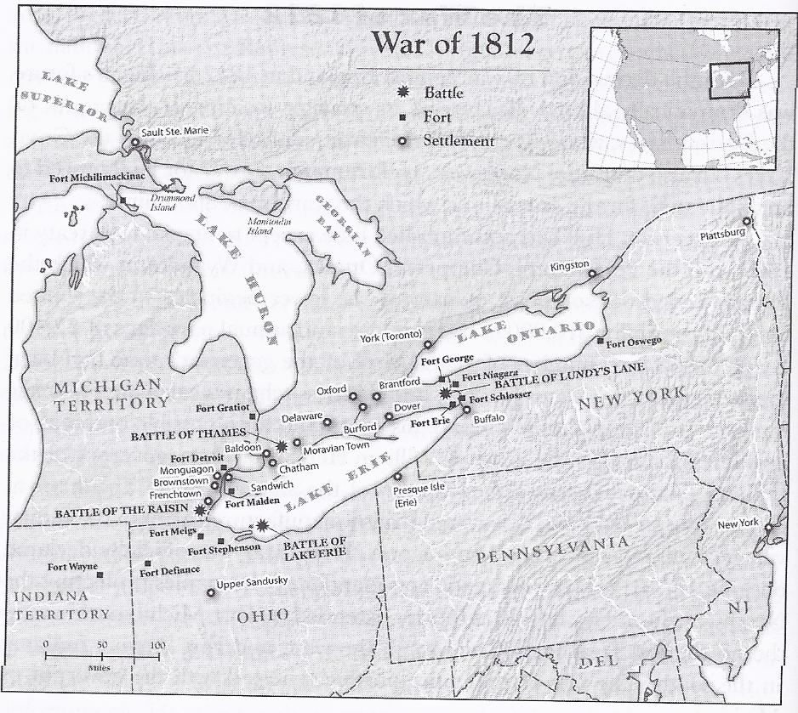
Bruce Rubenstein and Lawrence Ziewacz, Michigan: A History of the the Great Lakes State, 4th Ed. (Wheeling, IL: Harlan Davidson, Inc, 2008), 60.

Slide 35
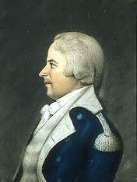
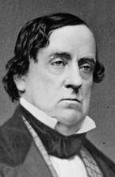
Michigan enters the war
After war started, Gov. Hull urged Pres. Madison to build more warships for the Great Lakes, but Madison was focused on invasion of Canada
Gov. Hull was appointed the commander of the North Western Army. He didn’t know war was declared until July 2, because the War Department sent notice to him via regular mail.
The British captured an American ship carrying Hull’s papers, so they knew Ft. Detroit had many more soldiers than Ft. Amherstburg had. The British learned Hull was very afraid of an Indian attack.
July 6 – Col. Lewis Cass visits Fort Amherstburg under a flag of truce, and later tells Hull that the fort was vulnerable.
http://en.wikipedia.org/wiki/William_Hull
Hull
Lewis Cass
http://blueandgraytrail.com/event/Election_of_1848
Fort Amherstburg (now Ft. Malden)
http://www.pc.gc.ca/eng/lhn-nhs/on/malden/natcul.aspx

Slide 36
Hull invades canada! (sort of)
July 12 – Hull and 2,000 men invade Canada through Windsor, BUT does not strike at Ft. Amherstburg, which had only 300 soldiers and 400 Indians.
Hull to Canadians: “If you should take part in the approaching conflict, you will be considered and treated as enemies, and the horrors and calamities of war will stalk before you.”

Slide 37
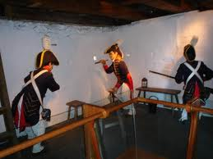
The British Strike at Mackinac Island
July 17, 1812 – British under Captain Charles Roberts, capture Fort Mackinac, prompting many Indians to side with British. Roberts learned about declaration of war on July 1, rallied 50 men and hundreds of Indians.
3 AM on July 17 - British landed on north side of Mackinac Island, marched to high ground to attack from the rear.
Lieutenant Porter Hanks (with only 61 men) surrendered without a fight
July 28 – News arrives in Detroit, but Hull still refused to strike at Ft. Malden, even though only 400 British officers and 270 of Tecumseh’s warriors defended it.
Photo: Jeff Lambrecht

Slide 38
The Battle of brownstown
After hearing of the surrender of Mackinac, Hull ordered the evacuation of Fort Dearborn in Chicago. As the people leave the fort, 400 Potawatomi Indians attack, killing about 45 men, women, and children.
Aug. 5, 1812 - Battle of Brownstown - Indians ambush American troops trying to re-supply Detroit at Brownstown Creek near present-day Gibraltar, killing 18. British learn of Hull’s precarious position in Detroit.

Slide 39
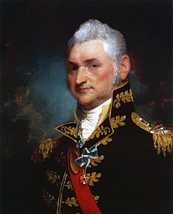
HULL ATTACKS! (JUST KIDDING)
Aug. 6, 1812 – Hull finally decides to attack Ft. Malden, though he was concerned about his supply lines.
Aug. 8, 1812 - Hull orders soldiers back to Detroit when he hears of British Gen. Isaac Brock’s reinforcement of Fort Malden. Brock met with Tecumseh on Aug. 13, and the opportunity to strike at Ft. Malden was lost.
General Henry Dearborn, headquartered in Albany, New York, was an old Revolutionary War hero and who, like Hull, was indecisive.
Henry Dearborn commanded American forces in the East.
http://en.wikipedia.org/wiki/Henry_Dearborn

Slide 40
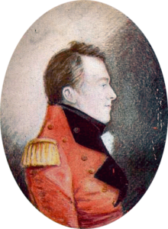
BROCK FOOLS HULL
http://en.wikipedia.org/wiki/Isaac_Brock
Americans’ delay in attacking the British at Fort Malden, caused by General Dearborn and General Hull, encouraged Gen. Brock to call on Detroit to surrender on Aug. 15.
Hull refused, and then was shelled by artillery from across the river. Seven men were killed.
Hull surrendered without a fight when his 1,000+ men believed that Indians were massing downriver, and reinforcements did not arrive. The Indians, by yelling, faked having more warriors than they had. In reality, Brock had only 730 soldiers and 600 Indians.
Gen. Isaac Brock planted a fake letter that claimed Ft. Amherstburg had 5,000 Indians to scare Hull into surrendering. He also faked having more troops by lighting individual campfires.

Slide 41
Brock orders hull to SURRENDER
“The force at my disposal authorizes me to require of you the immediate surrender of Fort Detroit. It is far from my intention to join in a war of extermination, but you must be aware, that the numerous body of Indians who have attached themselves to my troops, will be beyond control the moment the contest commences.”

Slide 42
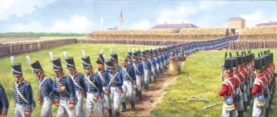
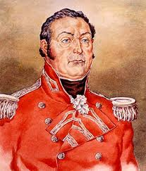
August 16, 1812
http://www.detroityes.com/mb/showthread.php?14478-battle-of-detroit-the-surrender-of-1812
Hull and several hundred men were taken prisoner in Quebec, leaving British Colonel Henry Procter in command in Detroit. A total of 2,500 Americans were captured.
Col. Henry Procter
http://en.wikipedia.org/wiki/Siege_of_Detroit
http://1812.myweeverapp.com/wp-content/uploads/2012/05/Procter_Prelude-to-War.jpg

Slide 43
The End of Gov. Hull
http://en.wikipedia.org/wiki/William_Hull
Hull was accused of cowardice, neglect of duty, conduct unbecoming of an officer (guilty) and treason (not guilty). Col. Lewis Cass blamed Hull solely for the surrender of Detroit. Future Ohio Governor Robert Lucas also testified against him.
President Madison prevented his hanging due to good Revolutionary War record.
Hull lived until 1825, and wrote two books trying to clear his name.
In fairness, Hull’s repeated calls to build warships for Lake Erie were ignored.

Slide 44
TWO VIEWS: HuLL VS. CASS
“We had only 800 soldiers in the fort…only about 600 healthy soldiers, and many of them were new…the fort and surrounding village and countryside was filled with women, children and the elderly…they would all die…or be kidnapped and tortured by savages…we did not have enough supplies. Our gunpowder and ammunition was almost all gone, and our food supply was dangerously low…When I realized that I was facing a British Army of 1,800 soldiers…I knew we could not win the battle…I didn’t ask for advice from my officers. The decision was mine alone.” - Gen. William Hull
“I am very angry and ashamed by his decision to surrender the fort and town. He made his decision based only on his emotions. He didn’t even ask for advice from his officers! We didn’t know he surrendered until we saw the white flag flying on top of the fort…There were never 1,800 soldiers! There were maybe 400 at most. We could have won the battle…if I had been in charge there would have been no surrender.” - Col. Lewis Cass

Slide 45
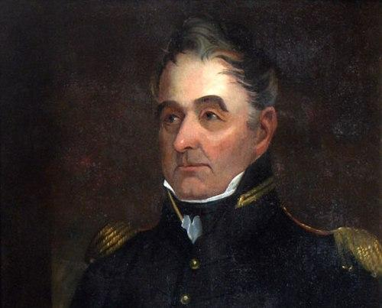
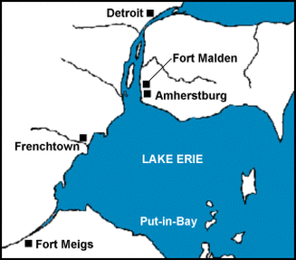
Battle of frenchtown (AKA Battle of THE River Raisin)
William Henry Harrison takes over for Hull, and raised an army to re-take Detroit.
Against Harrison’s order, Brig. Gen. James Winchester orders Col. William Lewis and 700 Kentucky militiamen to Frenchtown (modern day Monroe).
Jan 18, 1813 – Lewis attacks British, who disperse.
Jan. 20, 1813 – Winchester and 250 more men (total 934) arrive in Frenchtown, and disperse among the townspeople, ill-prepared for British counterattack.
Jan. 22, 1813 - Col. Henry Procter, commander of Detroit, launched surprise attack at dawn with force of 1,000-1,300 (majority of Indians). 300 Americans die, and 60 were seriously wounded. Winchester surrenders 500 Americans, in exchange for promise of protection from the Indians.
Procter leaves for Fort Amherstburg with the prisoners that could walk. He notes that the Indians are “fierce and unmanageable” as they rob the wounded Americans. Procter promises to return the next day with sleds to transport the wounded to the fort for care. The Americans request that more doctors stay to care for the wounded, but Procter tells them “The Indians are excellent doctors.”
http://wkar.org/post/war-1812-battle-river-raisin
Map: http://www.ultimatehistoryproject.com/commemorating-1812.html

Slide 46
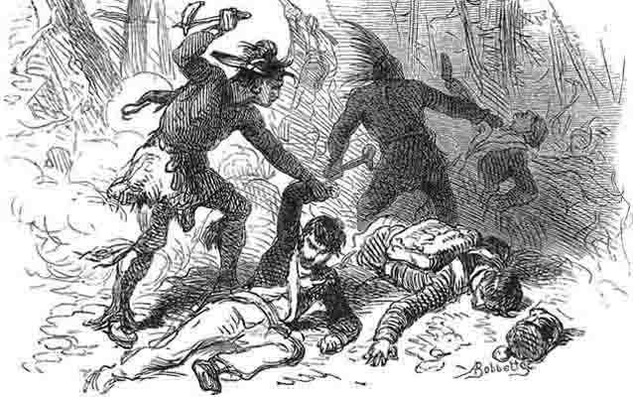
Raisin River Massacre – Jan. 23, 1813
200 Indians attack Frenchtown, killing 10-30 wounded prisoners, and burning the town. In total, 940 of 1,000 Americans were killed, wounded or captured during Battle of Frenchtown and the accompanying Raisin River Massacre. The bloodiest battle ever fought on Michigan soil, it became the rallying cry of the Americans, “Remember the Raisin!”
http://www.nps.gov/rira/forteachers/classrooms/remember-the-raisin-adventure.htm
British Colonel Procter was greatly criticized by Detroiters for the Indian massacre. He declared martial law, and arrested many people, including Father Gabriel Richard. Winchester was a prisoner for over a year in Canada. In 1819, he founded Memphis, TN with Andrew Jackson. He died in 1826.

Slide 47
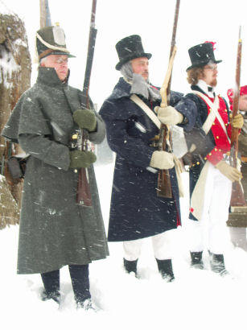
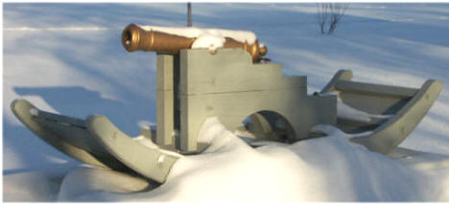
River raisin battlefield
http://www.riverraisinbattlefield.org/soldiersfare.htm
The British had several of these 3 lb. winter gun sleds. It could fire a 3 lb. ball about half a mile.
http://www.riverraisinbattlefield.org/artillery.htm
Men from the Michigan Legionary Corps and the 2nd Michigan Territorial Militia Regiment fought with poorer Kentucky volunteers.
http://www.riverraisinbattlefield.org/visitorscenter.htm

Slide 48
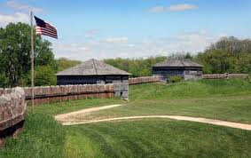
The Tide of War changes
Gen. Harrison, with funds from Ohio Governor, Return Meigs, orders the construction of Fort Meigs in Ohio in Feb. 1813, just south of Toledo
May 1813 – British Col. Procter and Indian allies under Tecumseh attacked for 9 days, but can’t overrun fort because Indians lose interest
Fort Meigs is the largest wooden walled fort in America, measuring 10 acres
Col. Henry Procter
http://1812.myweeverapp.com/wp-content/uploads/2012/05/Procter_Prelude-to-War.jpg
http://www.touring-ohio.com/history/fort-meigs.html

Slide 49
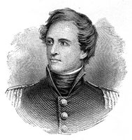
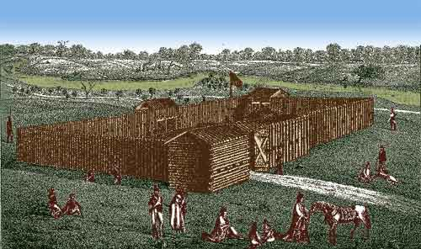
Major George Croghan
Nephew of George Rogers Clark (Battle of Vincennes) and William Clark (Lewis and Clark)
Fought in the Battle of Tippecanoe in 1811
Gov. Harrison wanted Croghan to abandon the fort, believing he was hopelessly outnumbered. Croghan writes to Harrison: “We have decided to maintain this place, and by Heaven we can.”
British surround fort and demand surrender, but 2nd Lt. Shipp tells them: “When the fort shall be taken, there will be none to massacre. It will not be given up while a man is able to resist.”
Croghan then tells Shipp: “Shipp, come in, and we'll blow them all to hell!”
Defended Fort Stephenson in Ohio against Procter and 400 British and 200 Indians, with only 160 men and 1 six-lb cannon called “Old Betsy.” Croghan lost only one man and seven were wounded while killing 50 British (including all the officers).
TURNING POINT OF THE WAR OF 1812
Croghan was promoted to Colonel and was awarded the Congressional Gold Medal 23 years later.
http://www.touring-ohio.com/northwest/fremont/fremont.html
http://www.touring-ohio.com/history/fort-stephenson.html
Colonel Mills Stephenson sited and built the fort in June 1812. Croghan, only 21 years old, defended it on July 31 - Aug. 2, 1813.

Slide 50
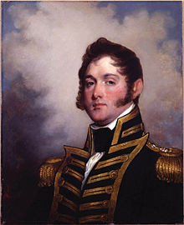
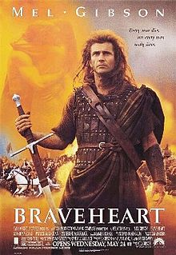
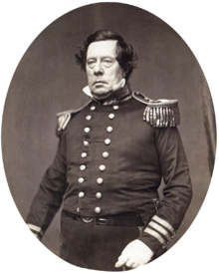
Comm. Oliver Hazard Perry
Perry was a direct descendent of William Wallace, who led the Scots in a war for independence against England in the 13th century.
At start of the war, British Navy outnumbered American ships 17 to 1.
Oversaw the construction of the American fleet. Commanded 9 ships in Lake Erie.
Prevented British ships from re-supplying Fort Amherstburg by waiting in Put-in-Bay
Sept. 10, 1813 – The Battle of Lake Erie
http://en.wikipedia.org/wiki/Oliver_Hazard_Perry
http://en.wikipedia.org/wiki/Braveheart
His younger brother, Matthew, “opened” Japan in 1853
http://en.wikipedia.org/wiki/Matthew_C._Perry

Slide 51
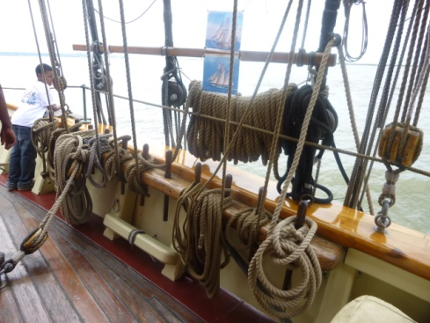
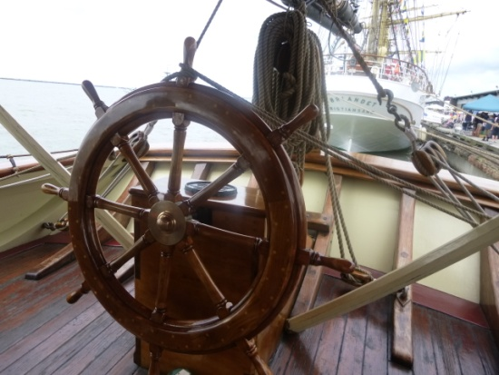
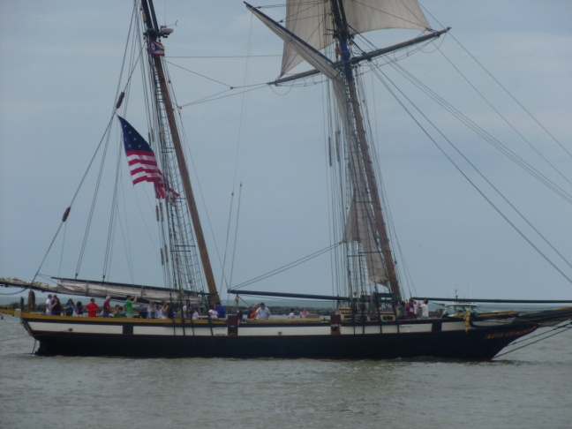
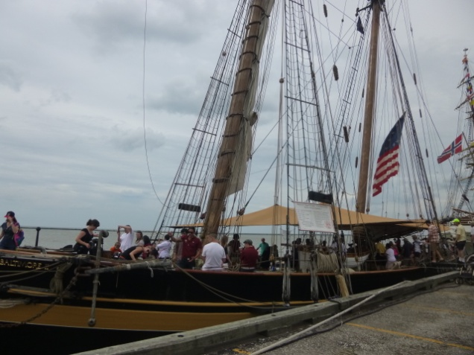
The Role of Privateers in the War
Privateers were “pirates” hired by the U.S. gov’t to raid unarmed or lightly armed British merchant ships. 500 privateer ships raided 2,500 British ships. Both the Lynx and the Pride of Baltimore II were in the reenactment of the Battle of Lake Erie.
Lynx
Topsail Schooner
122’ long, 23’ wide
Pride of Baltimore II
157” long, 26’ wide
Photos: Jeff Lambrecht

Slide 52
The Battle of Lake Erie – Sept. 10, 1813
Perry (9 ships) vs. Barclay (6 ships, but had long-range guns)
Perry’s ship sailed close enough that British guns were ineffective. Still, his ship, the Lawrence, was badly damaged and 80% of his crew dead or injured.
When Lieutenant Elliott disregarded orders to bring his brig, Niagara, into the fight, Perry rowed over to it, through a hail of bullets, and brought it into action, turning the tide of the battle
“We have met the enemy and they are ours, two ships, two brigs, one schooner, and one sloop.”
Victory paved way for Harrison to re-take Detroit because British could not re-supply Ft. Malden

Slide 53
September 10, 1813 The Battle of Lake Erie
http://www.hnsa.org/ships/niagara.htm
https://mstartzman.pbworks.com/w/page/31221332/Battle%20of%20Lake%20Erie%20(sixth)

Slide 54
The Niagara was the ship Perry used to turn around the Battle of Lake Erie
http://www.touring-ohio.com/northwest/sandusky/victory-memorial.html
The 352-foot Perry’s Victory and International Peace Monument in Put-In-Bay, Ohio is the world’s tallest Doric column, completed in 1915. It symbolized the new friendship between the United States and Great Britain, which had been enemies during the 19th century.
http://www.hnsa.org/ships/niagara.htm

Slide 55
The British Retreat
Sept. 24, 1813 – British abandon and burn Fort Amherstburg. The Americans partially rebuilt and rename it Fort Malden.
Sept. 26, 1813 – British abandon Detroit
Oct. 4, 1813 – Battle of the Thames – Procter and Indian allies under Tecumseh try to stop advancing American army near Thames River in Canada. Tecumseh killed, so Indians scatter.
General Procter was court-martialed after British defeat, and was suspended for six months. His military career ended in disgrace.
http://cincinnati.com/blogs/ourhistory/2012/09/05/key-war-of-1812-players-had-ties-to-region/
http://www.posterbobs.com/services96.html

Slide 56
Sept. 29, 1813 – Detroit returns to Americans
Fort Detroit is re-named Fort Shelby, in honor of Kentucky Gov. Isaac Shelby, who sent 3,500 Kentuckians into war (many died in River Raisin Massacre). The fort was abandoned in 1826.
Lacking supplies, Harrison retreated from Canada back to Detroit, and he and Perry were treated as national heroes
Harrison was the second-oldest POTUS at age 68 (Reagan was 69), and he died of pneumonia after 32 days in office.
Perry died of yellow fever in 1819 (34 years old). He is buried in Newport, RI
http://dstribling.wordpress.com/category/w-h-harrison/
http://en.wikipedia.org/wiki/Oliver_Hazard_Perry

Slide 57
Lewis Cass becomes Governor
Harrison and Perry leave Detroit, and President James Madison appoints Lewis Cass as governor of the Michigan Territory on Oct. 29, 1813 (remained for 18 years). Cass was a brigadier general in the Battle of the Thames, and he believed Indians, mostly still loyal to British, must be forced to move out of Michigan.
Gov. Lewis Cass 1813-1831.
Cass is one of only two Michiganders in the National Statuary Hall in Washington DC (along with Gerald Ford). Father Jacques Marquette represents Wisconsin, which became a state in 1848.
http://www.nndb.com/people/224/000050074/
http://en.wikipedia.org/wiki/Treaty_of_Greenville_(1814)

Slide 58
The Battle of Mackinac Island (Aug. 1814) The Americans try to recapture Mackinac
British build fort on high ground above Fort Mackinac (Fort George) to prevent American invasion.
American Brig. Gen. William Clark captured Prairie du Chien in Wisconsin, so the British prepare for assault on Mackinac Island.
The Americans, under Col. George Croghan and Maj. Andrew Holmes launch a surprise attack on Fort Mackinac, but 290 Indians and British troops ambushed them, killing Holmes and 12 others.
For two days, ships tried to fire on Fort George, but couldn’t elevate guns high enough to fire on fort.
British occupied Mackinac Island until end of war, even capturing two American ships
Americans re-occupied Mackinac in 1815 under peace treaty. Changed Fort George to Fort Holmes, in honor of Andrew Holmes.
Photo: Jeff Lambrecht
Battle
Ft. George
http://en.wikipedia.org/wiki/Fort_Holmes

Slide 59
The Treaty of Ghent, Dec. 1814
Duke of Wellington, who defeated Napoleon at Waterloo, turned down offer to assume command in Canada to continue war
British were heavily in debt and tired of war
No real military winner
Treaty of Ghent called for int’l boundary line to be surveyed (Drummond Island made American, and Bois Blanc (Bob-Lo) made Canadian)
In 1828, British abandoned fort they built on Drummond Island

Slide 60
The End of the War of 1812
Maj. Gen. Andrew Jackson wins the Battle of Horseshoe Bend against Indian allies of Tecumseh in 1814, and the Battle of New Orleans in Jan. 1815 after the Treaty of Ghent was signed.
Rush-Bagot Agreement = U.S. and Britain can’t maintain armed vessels on the Great Lakes.
http://en.wikipedia.org/wiki/Battle_of_Horseshoe_Bend_(1814)
After Horseshoe Bend, the Creek Indians were forced to sign a treaty giving up 23 million acres.
Considered the greatest land victory of the war, on January 8, 1815, American forces inflicted casualties on the British by a 20-1 ratio.
http://www.knowla.org/entry/724/
http://en.wikipedia.org/wiki/Battle_of_New_Orleans

Slide 61
Consequences of the war
Harrison uses fame to become President in 1840
Jackson uses fame to become President in 1828
Michigan now safely American, and British never seriously threatened again.
Northwest Territory now open to white settlement with Indian threat removed. Indians had to sign treaties ceding their land.

Slide 62
The Tiffin Report
Edward Tiffin = Surveyor General of the U.S. sent surveying party to Michigan in 1815, to give veterans of the War of 1812 two million acres of land.
Wrote report in 1816 that Michigan was full of swamps, lakes, and poor sandy soil, so not worth surveying. Very little arable land, so Congress gave Illinois and Missouri land to veterans
Report was not widely publicized in the 1820s, so it did not damage Michigan’s reputation.
Disease (malaria, typhoid fever) did hurt Michigan’s image. Land was also not surveyed or even purchased yet.
http://en.wikipedia.org/wiki/Edward_Tiffin
Tiffin was the first governor of Ohio in 1803. With his report, he started the Michigan-Ohio feud that continues today.

Slide 63
Trouble attracting settlers
Water travel was dangerous (Lake Erie considered more dangerous than Atlantic)
On land, had to cross the Great Black Swamp in NW Ohio (drained and settled in late 1800s). It was created by retreating glaciers, and the water was waist deep in some areas.
The area is now fertile farmland. Since 1993, Bowling Green celebrates the Black Swamp Arts Festival every September.
http://commons.wikimedia.org/wiki/File:Black_Swamp.jpg
Magee Marsh on Lake Erie is the remnants of the Great Black Swamp. Ohio has lost 90% of its wetlands.
http://www.bgfile.com/projects/tcom/sites/culture/blackswamp/shannonwhetsel/index.html
http://blogs.bgsu.edu/blackswampjournal/2011/04/14/history-of-the-great-black-swamp/

Slide 64
Detroit (AGAIN) Incorporated in 1815
Plague killed 400-700 people in Detroit in 1814.
With a population of 850 (MI has <5,000 total), Detroit is incorporated as a city with a board of trustees (later called the Common Council in 1824). Wayne County shrinks to its present size.
Only city in Michigan Territory when it became a state in 1837.
In 1816, construction starts on first road from Detroit to Pontiac along an old Indian trail. The road later becomes Woodward Avenue.
In 1817, Detroit-Toledo road was completed, bypassing the Great Black Swamp.

Slide 65
Michigan: A Leader in Public Education
http://www.hal.state.mi.us/mhc/timetraveler/newspapers/firstpapers.html
First state to put funds from sale of land in Section 16 into a state fund
Ftr. Gabriel Richard petitioned Gov. Hull to build a college. Built several schools, even one for Indians
1817 – Judge Woodward proposes the Catholipistemiad, or University, of Michigania. It was actually a centralized school system for kids of all ages. Taxes and a lottery would largely support, together with a low tuition. SEE NEXT SLIDE
http://www.umich.edu/~aahist/carlos1820b.html

Slide 66
University of Michigan, 1817
Gov. Cass supported Woodward’s plan
Rev. John Monteith and Ftr. Gabriel Richard, who were good friends, founded the University of Michigania (actually a primary school and academy)
1821 – Board of Trustees takes over (now called U of M)
1837 – Moved to Ann Arbor
1841 – First classes held
1845 – First graduating class of 11 men
1856 – MI Supreme Court rules that U of M could claim that 1817 was its founding
Monteith was a Presbyterian minister,
and was president from 1817-1821

Slide 67
ALSO IN 1817
1817 – Law passed allowing hogs to roam streets if had a nose ring to prevent eating grass
1817 – The first regular newspaper, the Detroit Gazette, is published. Initially, some of the articles were in French. It discontinued publication in 1830.
President James Monroe visited Detroit, the first POTUS to do so, and Monroe County is named in his honor

Slide 68
Walk-in-the-Water (1818)
The first steamboat (135’) on the Great Lakes. Known at the time as “the steamboat” because there were no other steamboats for three years.
Made trips from Buffalo to Detroit for $7.00. First trip took 44 hours with 29 passengers.
Wrecked in a Halloween storm on Lake Erie in 1821, but the engine was salvaged. The first steam sawmill in the Saginaw Valley used the engine from the Walk-In-The-Water.
http://www.jimwegryn.com/Names/Ships5.htm

Slide 69
Surveying Michigan (1815-1851)
- Established 6 sq. mi. townships with a base line and the prime meridian south from Sault Ste. Marie. All land is measured from these lines.
Township numbers
Meridian-Base Line State Park
is located in Jackson and Ingham
Counties, and is not open to the
public because it is inaccessible.
http://www.waymarking.com/waymarks/WMA4FT_Michigan_Meridian_Baseline_State_Park
http://www.geography.hunter.cuny.edu/~jochen/GTECH361/lectures/lecture04/concepts/Map%20coordinate%20systems/Public%20Land%20Survey.htm
http://activerain.com/blogsview/2057301/the-michigan-meridian-that-survey-line-that-links-us-to-ohio-defiance-ohio-

Slide 70
The Treaty of Saginaw (1819)
Gov. Lewis Cass brought provisions and alcohol for the Indians
Negotiated for two weeks
1,500-4,000 Indians were involved. Indians were offered $3,000 in silver coins, but Louis Campau claimed the Indians owed him $1,500.
Indians accepted, and Michigan received 6 million acres for $3,000 in silver coins, and $1,000 per year forever plus “whatever additional sum.” Cass didn’t know what the land was worth.
Campau didn’t get his money, so he opened 10 barrels of whiskey and got the Indians drunk
Reservations established, but Secretary of War John Calhoun wanted Indians to move west
http://bay-journal.com/maps/1819-saginaw-treaty.html

Slide 71
Selling Land
Federal government, which bought the land from the Indians, starting selling land.
First land auction in Michigan was in Detroit in 1818. The minimum bid was $2/acre for 160 acres, and the average was $4/acre, but highest was $40/acre. In 1820, Congress reduced price to $1.25/acre, and minimum size to 80 acres.
Buyers paid in gold or silver or bank note
Received a “patent” (deed) signed by the President of the United States (until 1833)

Slide 72
The Cass Expedition – May 25, 1820
To combat the Tiffin Report, Cass took 65 men on an expedition
Captain David Douglass = geographer (topography, flora and fauna)
Henry Schoolcraft = geologist (mineralogist)
Schoolcraft named many Michigan counties with “faux Indian” names like Alcona, Algoma, Allegan, Alpena, Arenac, Iosco, Kalkaska, Leelanau, Oscoda, and Tuscola.
http://www.answers.com/topic/henry-schoolcraft

Slide 73
Purpose of the Cass Expedition
Survey the geography and topography of the region in order to produce a complete map
Survey the flora and fauna of the region
Survey the Indians of the region, their numbers, tribes, customs, and loyalties, whether to the United States or Great Britain.
Select and buy sites for forts, especially at Sault Ste. Marie (Fort Brady).
Survey the geology (commercially valuable minerals)
Search for the source of the Mississippi River

Slide 74
The Cass Expedition (4 months)
Left from Detroit, went to Mackinac Island, then Sault Ste. Marie, where encountered hostile Chippewas with British flag (Chief Sa-sa-ba), but who ceded 16 sq. miles along St. Mary’s River. Fort Brady later built there.
Explored southern shore of Lake Superior, cut across bottom of Keweenaw Peninsula, headed west to Mississippi River to try to find source, but failed
Went down the Mississippi River, then returned via Green Bay, then Chicago, across the Old Sauk Trail (now U.S. 12 – Michigan Avenue)
Report was more favorable (Indians were peaceful, land was fertile, found copper and iron)
Entire trip cost $6,300, and went 4,200 miles (35 miles per day for 4 months)

Slide 75
The 1820 Cass Expedition (map created by Henry Schoolcraft in 1821)
http://www.raremaps.com/gallery/archivedetail/18304/Map_of_the_Northwestern_Territories_of_the_United_States_Showing_the_Track/Schoolcraft.html

